Slide 1





Eftsure inside D365 F&O
Architecture

Slide 2
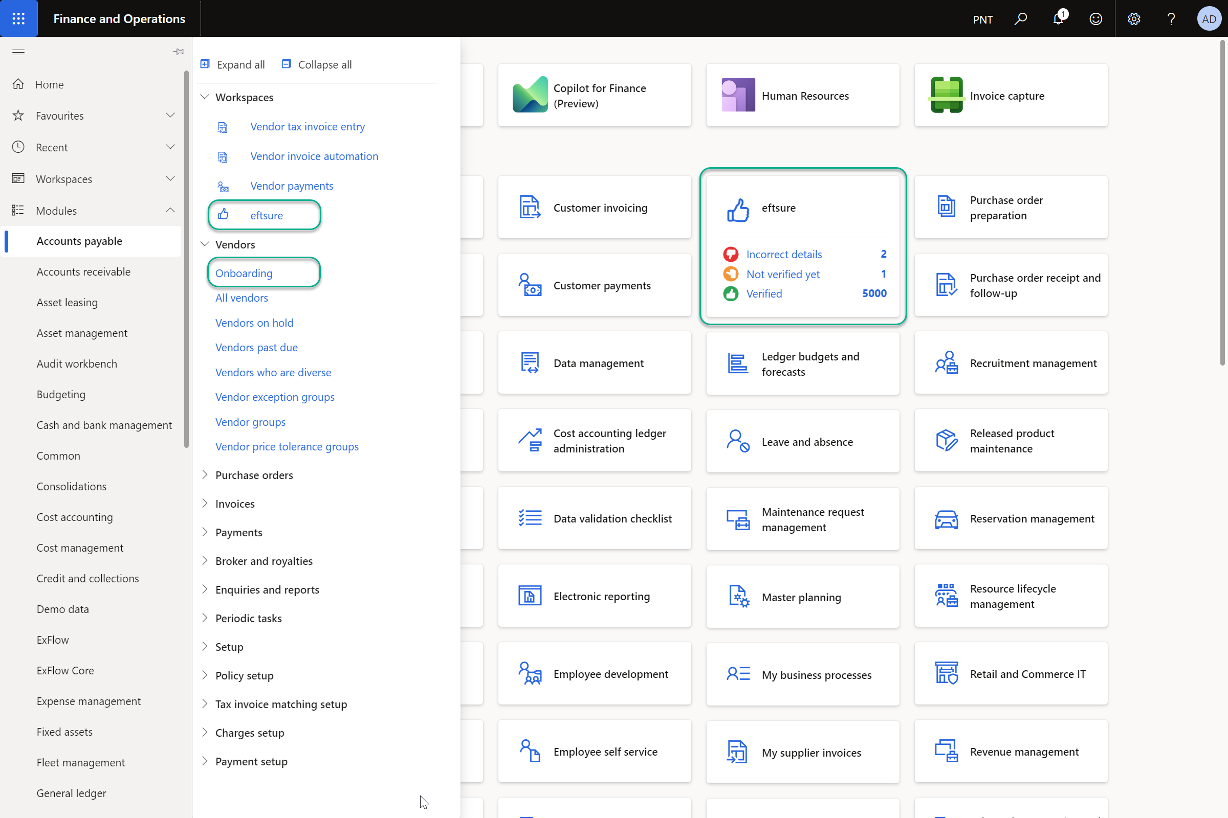

Slide 3


Solution objectives
Ensure you pay the “Right Payee” and the “Right Account”
Participate in cross matching using enterprise verified crowd data networks
Prevent brand reputation damage
Reducing payment fraud from internal and external threats
Preventing malicious actions and employee mistakes
Compliance Monitoring
Increase productivity
Reduced stress and Risks
Provide secure audit tracked onboarding workflows

Slide 4


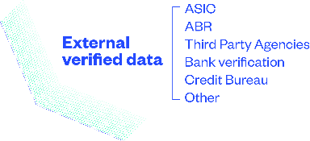














































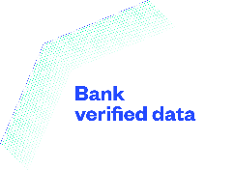
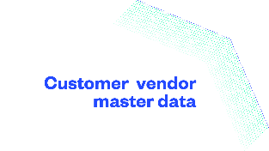

Slide 5























































































































Mining & Metals
Construction & Property
Government
Food & Consumer Goods
Education
Professional Services
Retail
Energy
Media & Marketing
Financial Services
Logistics & Infrastructure
Federal Agencies
Agriculture & Food
Automotive
Hospitality
Information Technology
Hospitals and Healthcare
Local Government
Community Service & NFP
Sporting Bodies

Slide 6
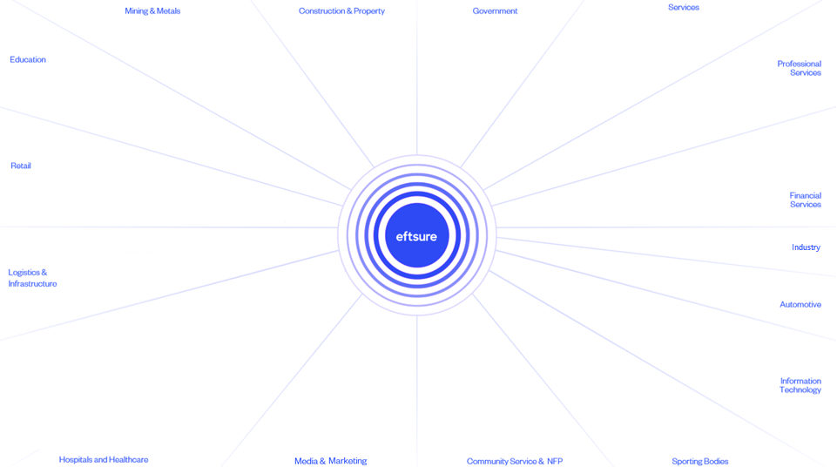



















































Slide 7
















SI, Sales, Deployment Partners
Technology & Global Partners

Slide 8





Seriously secure, powerfully private:
ISO Certified
Security Due Diligence
Full Code and Policy Review
TLS 1.3 256-bit
Architecture and Security Review
All data stored in Australia
Data Encrypted in transit & at rest
For more security information, please request our latest security pack and common security questions

Slide 9

International
Electronic onboarding &
Eftsure Verification
    Australia
    Canada
    Ireland
    New Zealand
    Philippines
    Singapore
    South Africa
    United Kingdom
    United States
Roadmap 2025:
China - Europe - India
Supported deployments:
AU – NZ – USA (Beta)
Electronic onboarding &
Self certification
Rest of the world

Slide 10
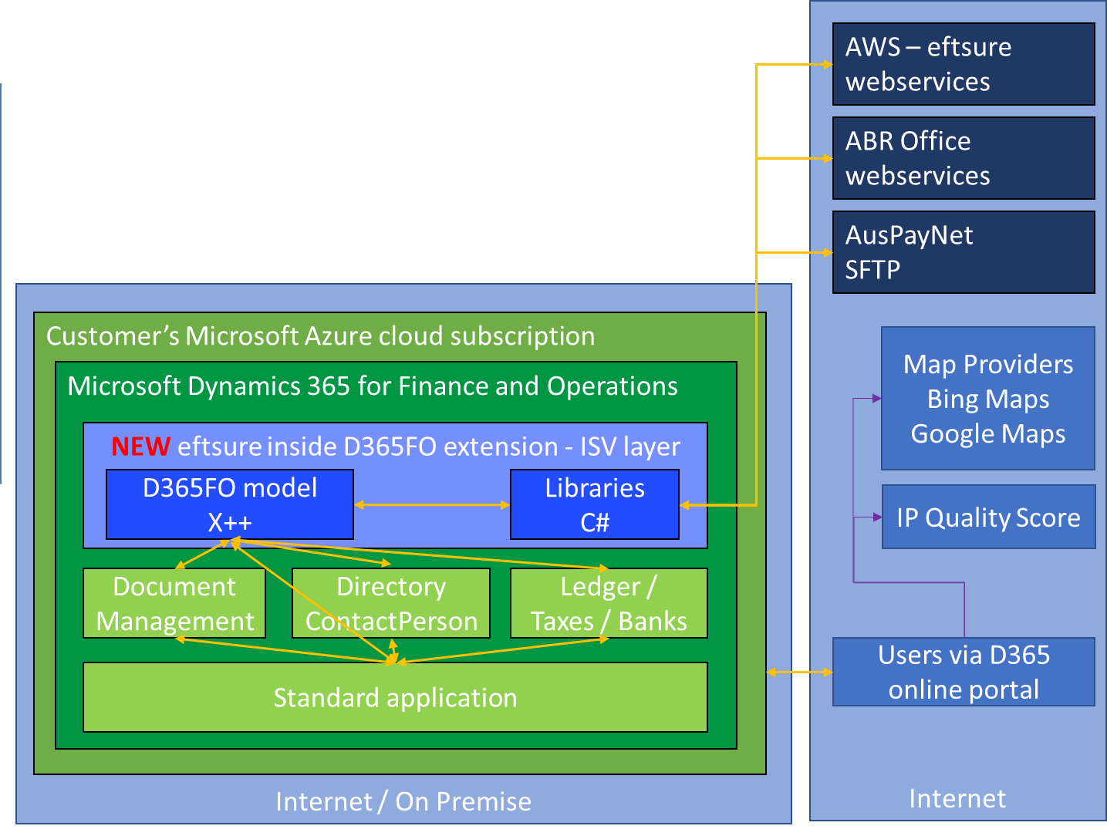
D365 F&O extension
Available as a single model extension in the ISV layer with “NO” over layering, responsible for synchronisation of the ERP master data with eftsure, as well as exposing eftsure features into the ERP
Has dependencies on the standard models, bank, currency, directory, contact, tax, and ledger by extending standard objects or subscribing to events
Additional C# libraries are available to query eftsure crowdsourced database [REST API] and other providers (ABR Office, IP Quality Score, email & phone number validation…)
eftsure inside D365FO Extension is fully integrated into our D365 master data and processes, and therefore can leverage all standard D365FO features such as Workspaces, Security, Document Management, Reporting, …

Slide 11
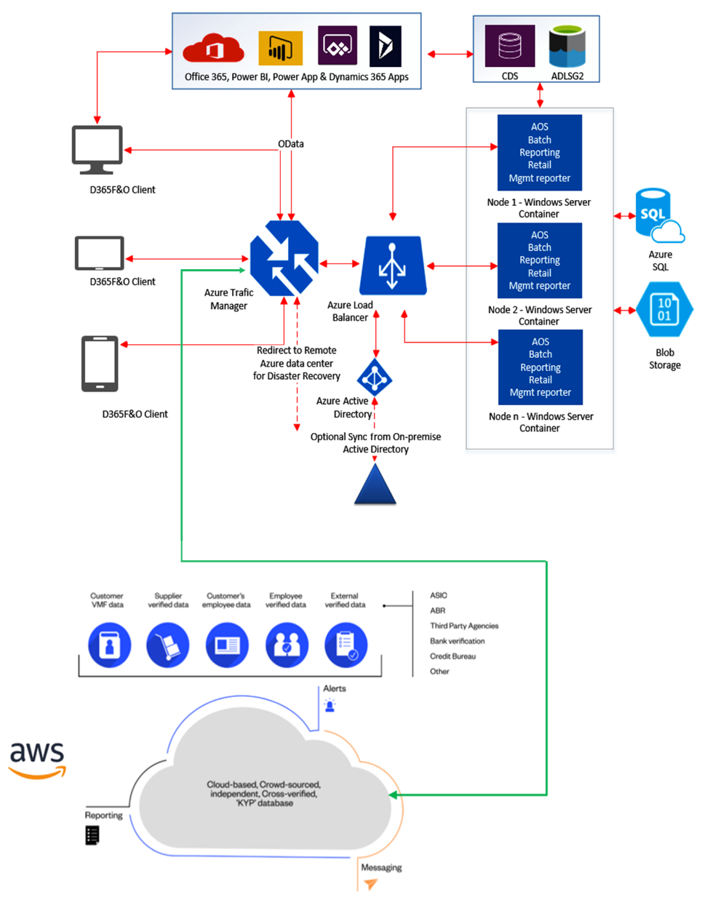

Architecture
Top section is the standard D365FO architecture [Red] hosted in Microsoft Azure cloud
Communication [Green] between D365FO with eftsure occurs over a highly available HTTPS/TLS1.3 connection
Bottom section is the eftsure architecture [Gray] on top of AWS (Amazon Web Services), hosted locally in South East Australia region

Slide 12
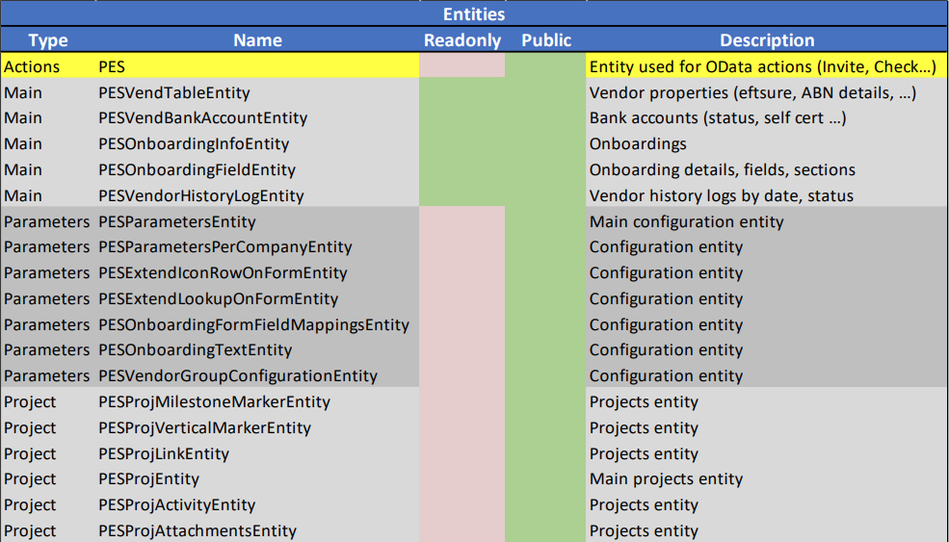
D365 Data entities
New data entities:
Eftsure data (readonly)
Configuration (cloud backup/restore)
New actions:
Invite, Check for Ext systems,
PowerPlatform, Web…
Purpose
Expose data/actions to external systems
Available for reporting, PowerBI…
Data Integration
External workflows
LoCode/NoCode apps
https://docs.microsoft.com/en-us/dynamics365/fin-ops-core/dev-itpro/data-entities/data-entities

Slide 13
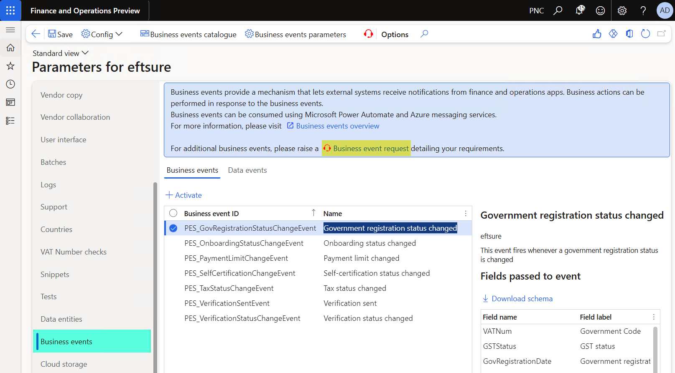
D365 Business Events
https://learn.microsoft.com/en-us/dynamics365/fin-ops-core/dev-itpro/business-events/home-page

Slide 14
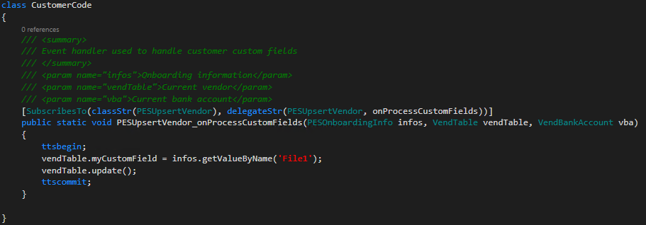
D365 Further extensions
Provide the ability to further extend eftsure processes:
Standard X++ development
Support for Custom onboarding fields, attachments, sections into customer custom fields.
Support for Custom placeholders in supplier invitation text.
Many delegates available in eftsure model
PaymentLimit
SelfCertified
VendorUpdated
VendorBankAccountUpdated
InvitationSent
InvitationProcessed…
https://docs.microsoft.com/en-us/dynamics365/unified-operations/dev-itpro/extensibility/extensible-code-delegates

Slide 15



Eftsure cloud
Live
Sandbox
Live Domain
User1@domain.ext
User2@domain.ext
Sandbox UAT
UAT_User1
UAT_User2
Sandbox Test
Test_User1
Test_User2
Sandbox XXX
XXX_User1
XXX_User2
Azure cloud
Live
UAT
Test
XXX / Dev / Gold…
Environment Live
D365 Users:
User1@domain.ext
User2@domain.ext
Eftsure users:
User1@domain.ext
User2@domain.ext
Environment Sandbox
D365 Users:
User1@domain.ext
User2@domain.ext
Eftsure users:
UAT_User1
UAT_User2
Environment Sandbox
D365 Users:
User1@domain.ext
User2@domain.ext
Eftsure users:
Test_User1
Test_User2
Environment Sandbox
D365 Users:
User1@domain.ext
User2@domain.ext
Eftsure users :
XXX_User1
XXX_User2
Recommended naming convention
for eftsure users in API v2 configuration
Zendesk (support)
Eftsure users (in User Options): User1@domain.ext
User2@domain.ext
Eftsure users (in User Options \ Support services):
User1@domain.ext
User2@domain.ext

Slide 16

Microsoft ISV - Certification
Microsoft requires specific reviews in order to validate our extension:
    Source code to meet Microsoft guidelines. (No errors/warnings/best practices)
    Microsoft Dynamics Lifecycle Services (LCS) solution package successfully bundled and delivered.
    Core independent software vendor (ISV) business scenarios can be transacted.
eftsure completes the following curation artifacts and tests:
    Code analysis report (CAR)
    Business process modeler (BPM)/test scripts
    Business database backup
    Project name and description
    Data packages
    Methodology
    Binaries (optional)
    Deployable packages
    Models (code and tests)
    Marketing content
https://docs.microsoft.com/en-us/dynamics365/fin-ops-core/dev-itpro/lcs-solutions/app-validation-lcs-solutions

Slide 17
Security
As a cybercrime prevention service, eftsure security measures follow the strongest industry standards and are fully documented in the security information guides
All transactions are secured using TLS1.2/1.3 over HTTPS
All credentials are encrypted at rest and during transit
Access to data centers is highly secured by partner AWS and access to D365FO instances is similarly protected by Microsoft
Vendor security practices are constantly under review and audit including penetration testing
Authentication Model for Internal User [Employees]
Users access D365FO environment as usual, which depends on Azure Active Directory Group permissions & D365FO permissions
Existing user roles have been extended to allow usage of eftsure features.
An eftsure credential is associated to each user performing eftsure actions and configured in the user options dialog
A generic eftsure credential may be used only for payment verifications when the user doesn’t have eftsure credentials configured
Authentication model for External User [Vendors]
Suppliers access D365FO system only if granted vendor collaboration permissions. Otherwise no access to D365 FO
Suppliers can be granted permissions to interact with RFQs, Purchase Orders… but can’t interact with their eftsure information from within ERP D365 FO
Suppliers can only complete invitations & verification in the eftsure portal. eftsure features are natively available to your Accounts Payable department
Suppliers authenticated in the eftsure portal and in D365 FO using their credentials & MFA, if granted vendor collaboration

Slide 18
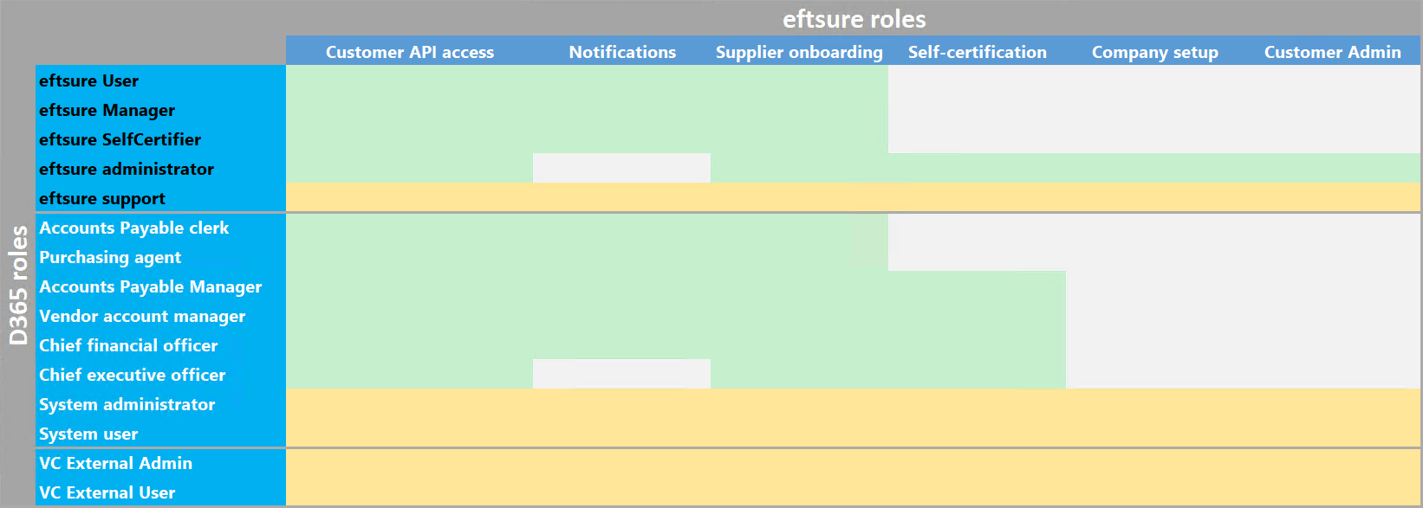
Security – User roles
List of new/customised roles.
Additional permissions can be granted by customer/partner customisations.
https://docs.microsoft.com/en-us/dynamics365/fin-ops-core/dev-itpro/sysadmin/role-based-security

Slide 19

eftsure inside ExFlow in D365 F&O
Electronic onboarding,
Automated Invoicing,
Secure Payment :
‘The Blueprint of the future
of AP Departments’

Slide 20
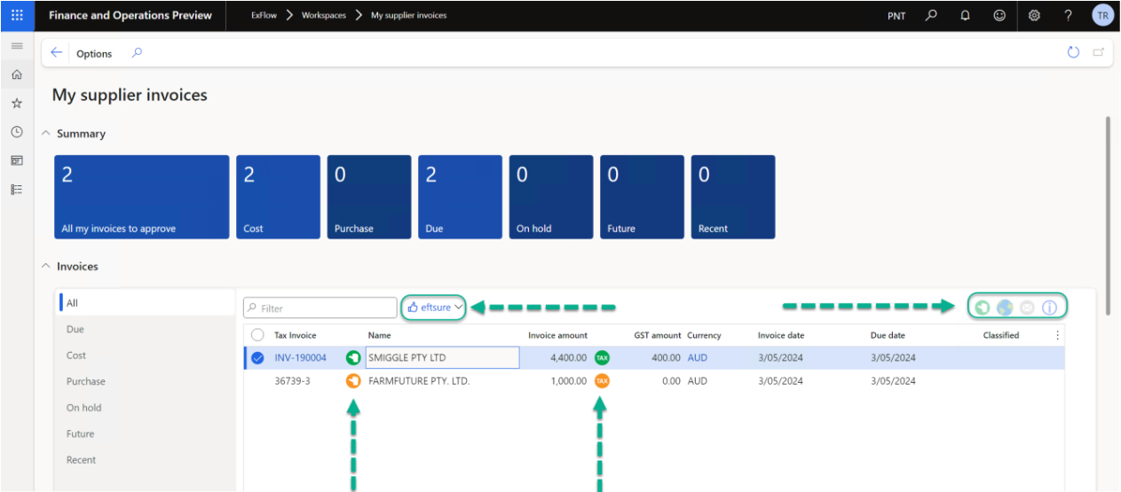
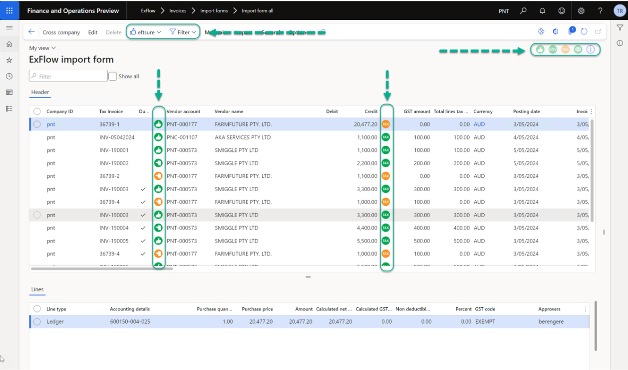
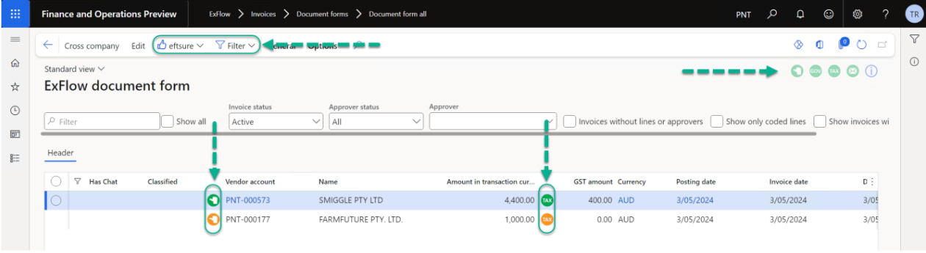
Exflow
Notes:
.

Slide 21
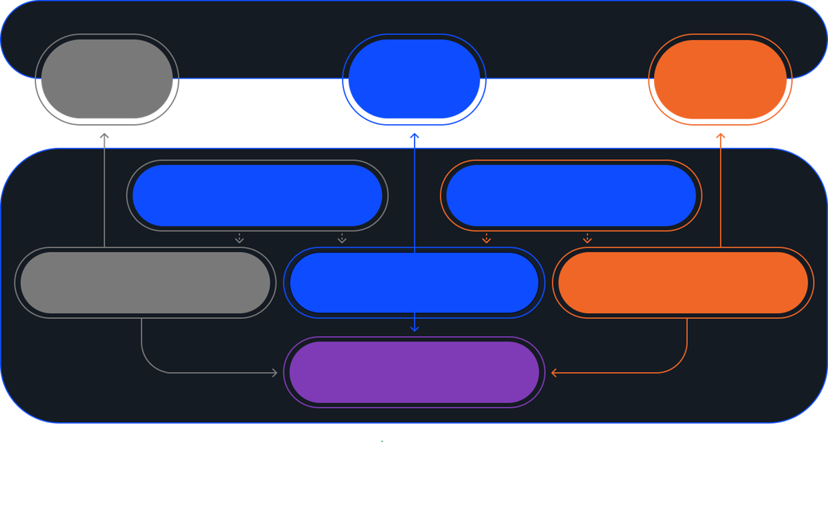




D365 Partnerships
ExFlow FO AP Automation
Accounts Payable and Invoice Process automation for Microsoft Dynamics 365 for Finance and Operation
Internet
Internet
Eftsure inside ExFlow
for D365 F&O
Eftsure inside Xe
for D365 F&O
Azure
Azure
Xe Global Payments for D365 Finance
Simplify & automate your global vendor payment process with a real-time embedded currency solution
ExFlow
Eftsure inside
Dynamics D365 F&O
Xe
Standard Application

Slide 22
Thank you!

Slide 23

Expert Call-back and Fraud Screening:
1. Expertise and Experience
The team are continuously trained on the latest scams and frauds.
2. Independently Source
Phone numbers are always independently sourced from a contact database or the suppliers’ website. A website is tested for legitimacy using methods below.
3. Always Outbound
No incoming information is used, ever.
4. IP Analysis
IP checks are run against location, characteristics and meta-data (e.g. type of browser, desktop or mobile) to assist in discernment of fraud.
5. Website Registration
The Website’s (DNS) registration date is checked and flagged if it is less than one year old.
6. Website Legitimacy
When a vendor website is used to source contact details the following evaluations are made; overall quality, image authenticity, link functionality, social-media links and the existence of authentic testimonials and reviews.
7. VPN Check
The use of a VPN may be a lead signal for attempted concealment of location and hence deception; both the use of and brand of a VPN is checked for.
Notes:
- XX, have you heard of eftsure before?
- Overview: run you through in 3 main parts:
- Who is eftsure?
- Case studies and fraud trends in the business market (to show you how our solution can help mitigate these things happening to you)
- Then, finally the product and how it will provide a solution.
How does that sound to you? Please feel free to jump in if you have any questions.
- Introduction – bit about me (ex-big 4 CA)
Quick summary of who eftsure is we are a pioneering.. fintech company founded to mitigate against payment fraud & error. We were founded 10 years ago by the team… (change slides)…..

Slide 24
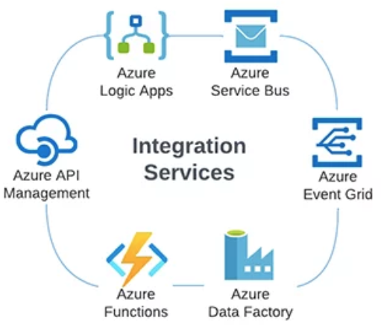
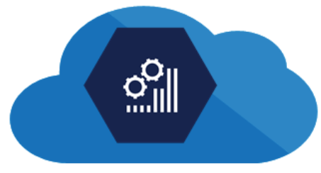










Azure
Eftsure inside
D365 FO
Dynamics 365 F&O
Custom
Low Code - No Code
3rd Party Apps
OData
Business Events
Recurring API
Custom
Custom Webservices
HTTPS / TLS

